Slide 1
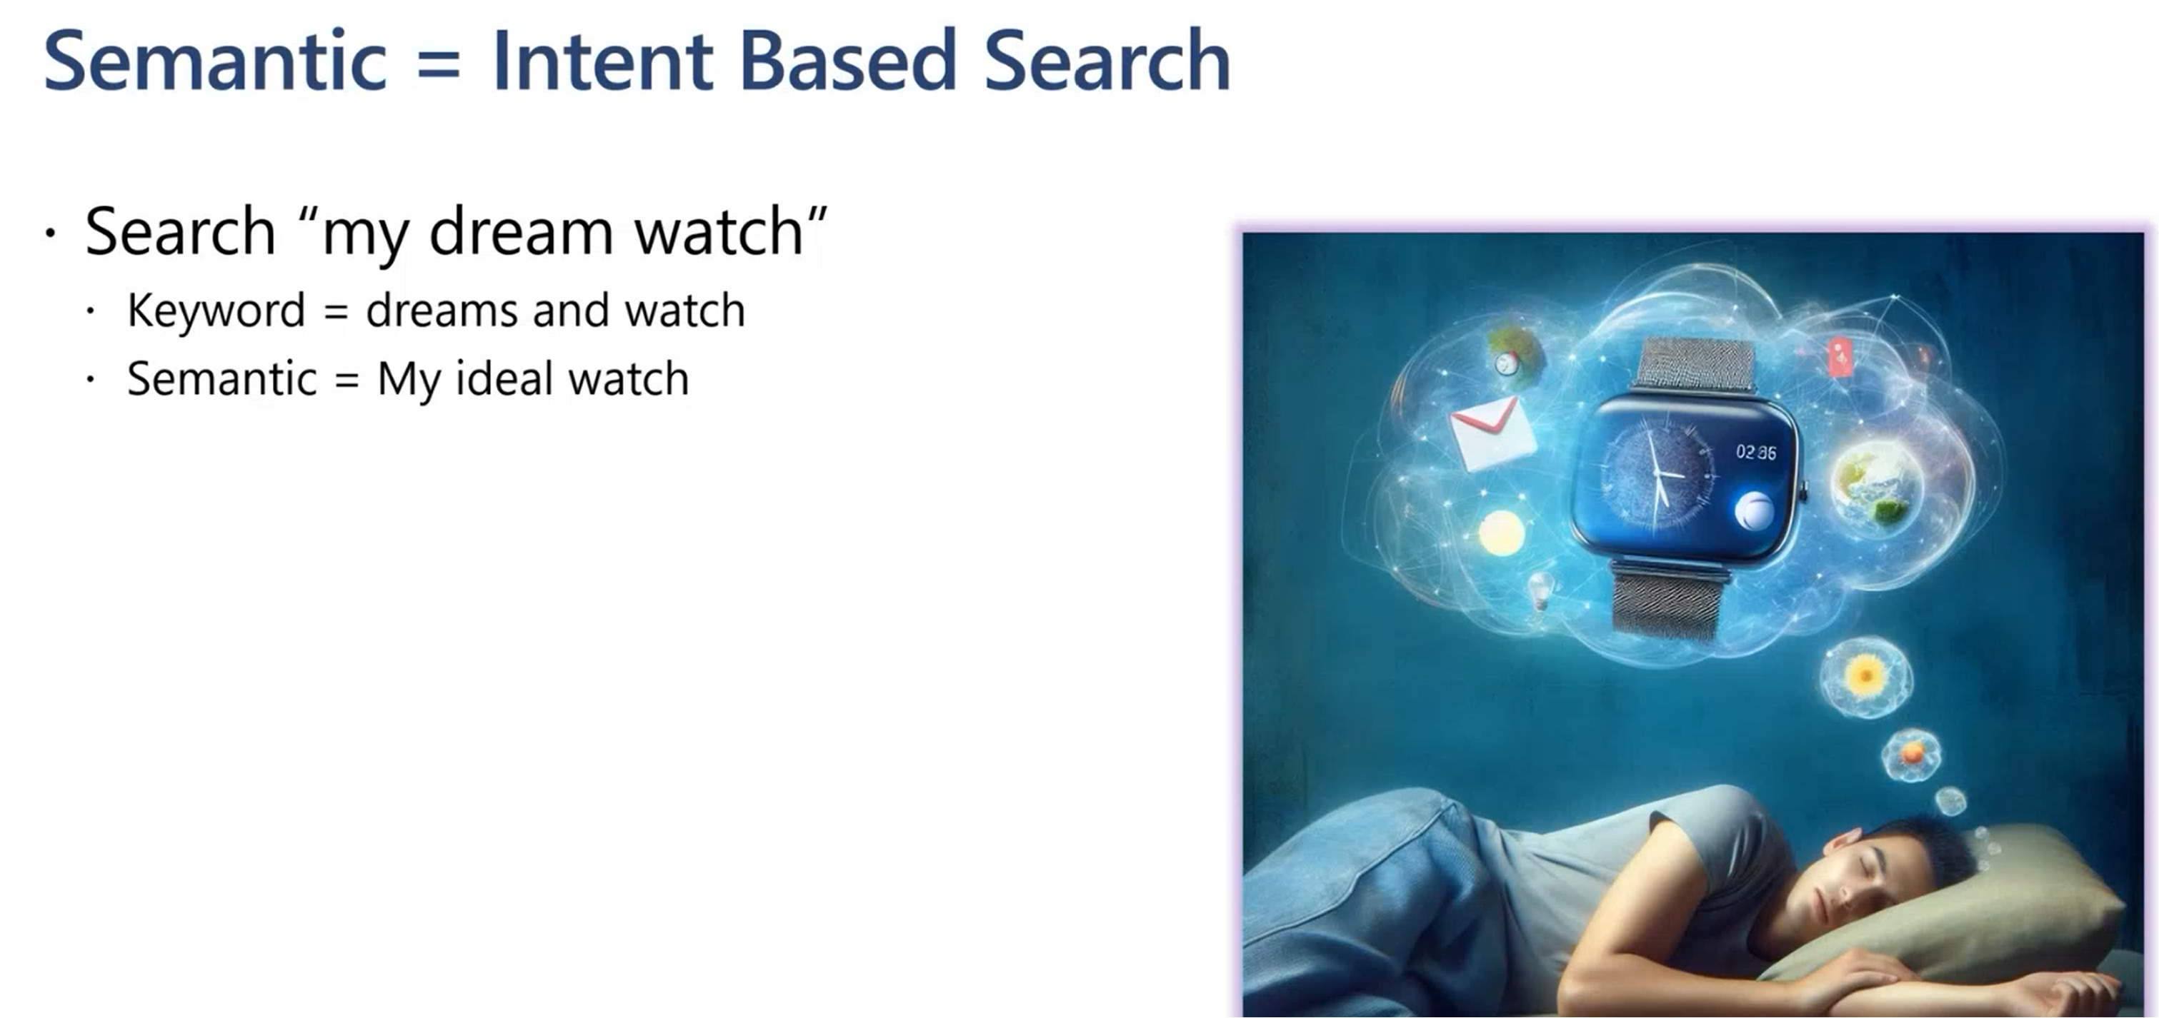

Slide 2
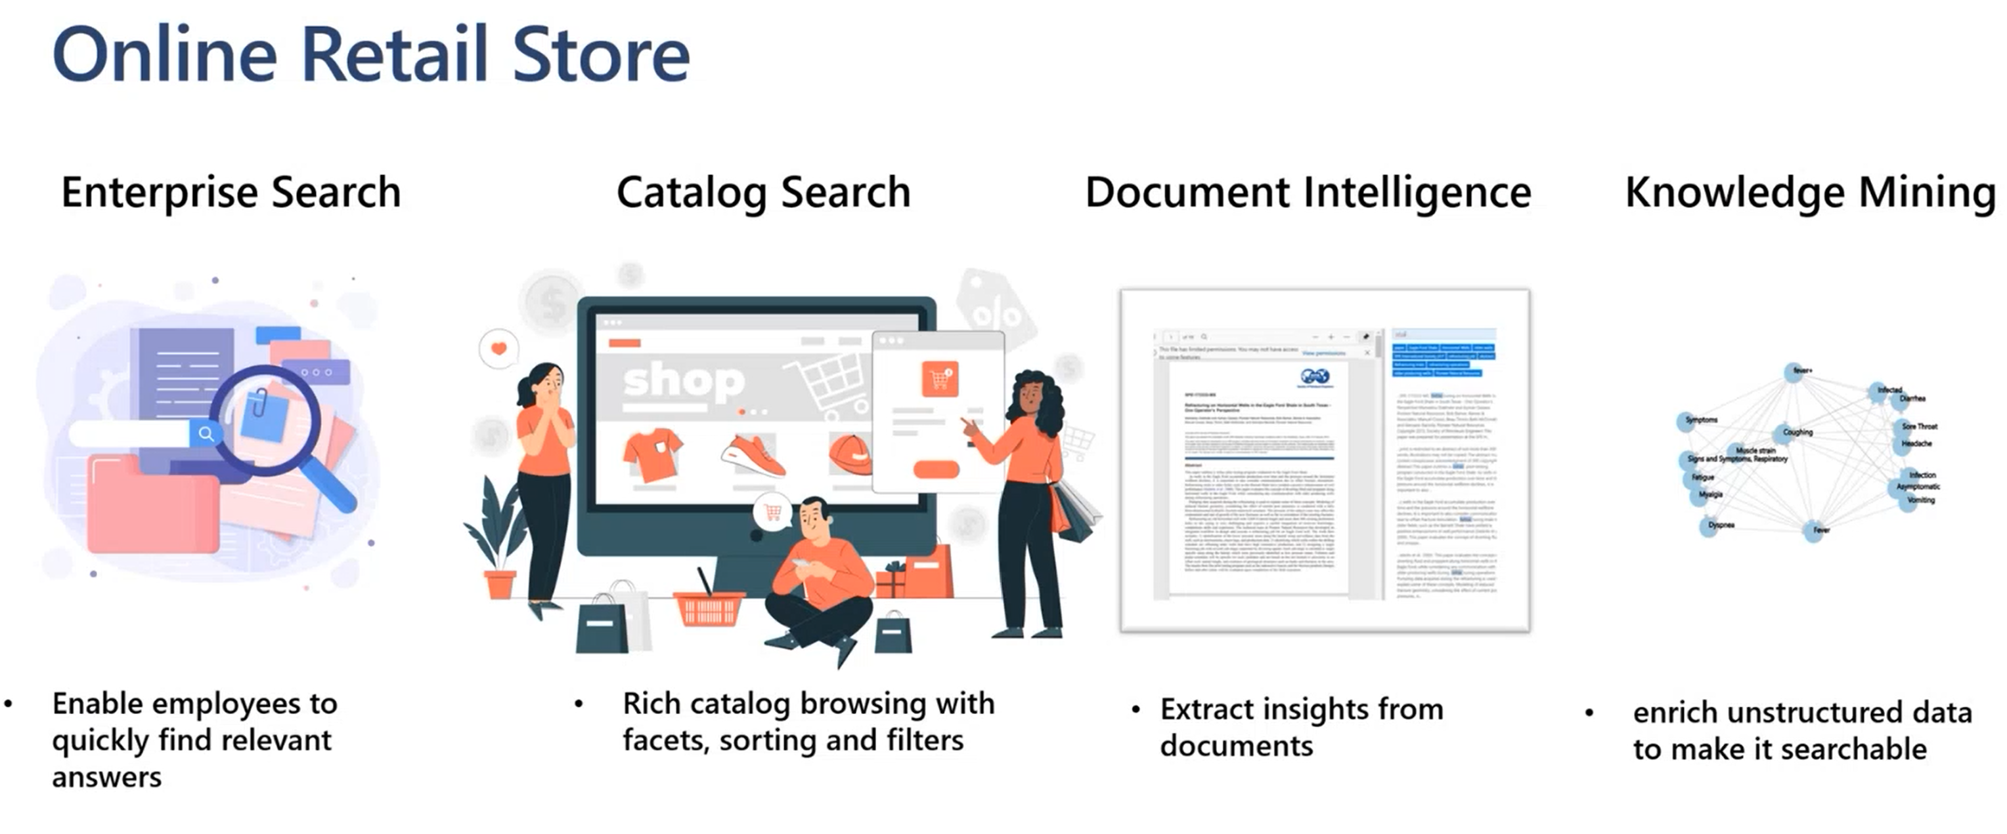

Slide 3
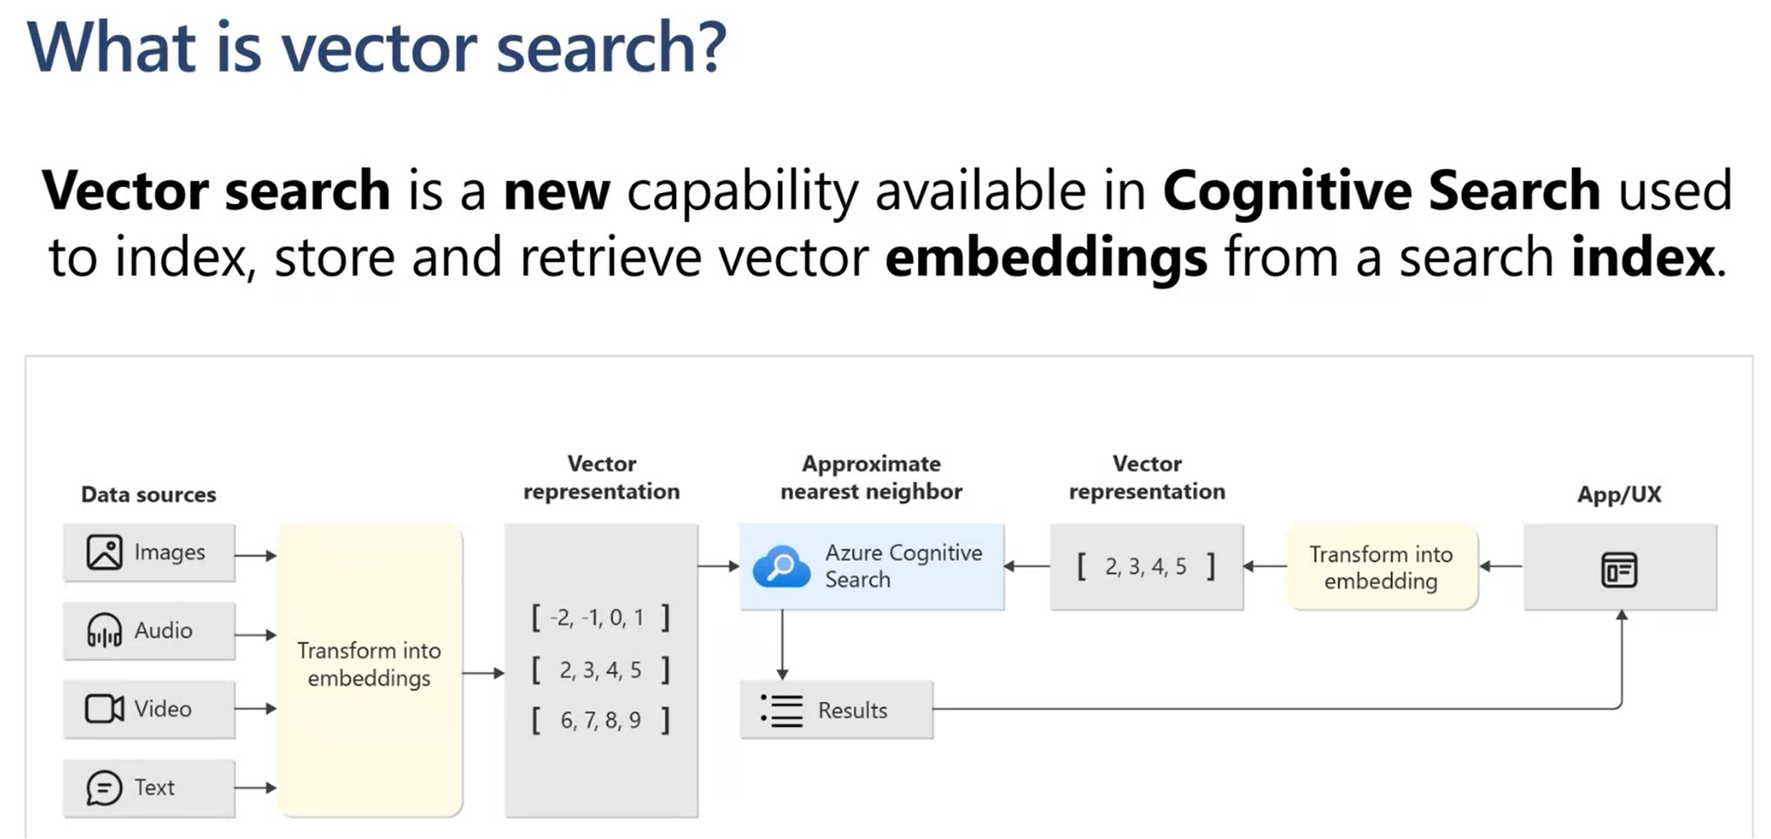

Slide 4

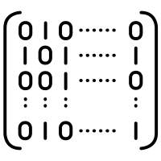




Text
image
Transform into
Embeddings
Audio
Video
Source Data
Embedding Service
Vector Data
Vector Data Base

Slide 5
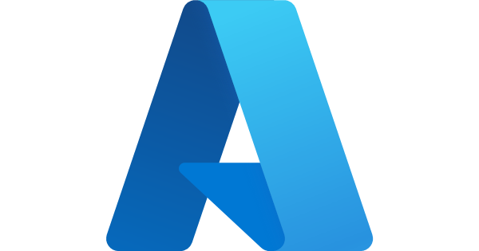








Vector Data Base
Insert
Source Data
Azure Open AI Embedding
Azure Cache for Redis
Vector Data
Azure AI Search
Search
azure computer vision
PostgreSQL
Query Data
Embedding service
Azure Cosmos
MongoDB
Top Similar
Vectors
Query Result
Fabric Kusto

Slide 6

Insert
Source Data
Azure Open AI Embedding
Vector Data
Search
azure document intelligence
Query Data
Embedding
Cosmos postgre
Top Similar
Vectors
Query Result

Slide 7
What is RAG (Retrieval-Augmented Generation)
RAG is an AI framework for retrieving facts from an external knowledge base to ground large language models (LLMs) on the most accurate, up-to-date information and to give users insight into LLMs' generative process.
Known challenges of LLMs include:
Presenting false information when it does not have the answer.
Presenting out-of-date or generic information when the user expects a specific, current response.
Creating a response from non-authoritative sources.
Creating inaccurate responses due to terminology confusion, wherein different training sources use the same terminology to talk about different things.

Slide 8

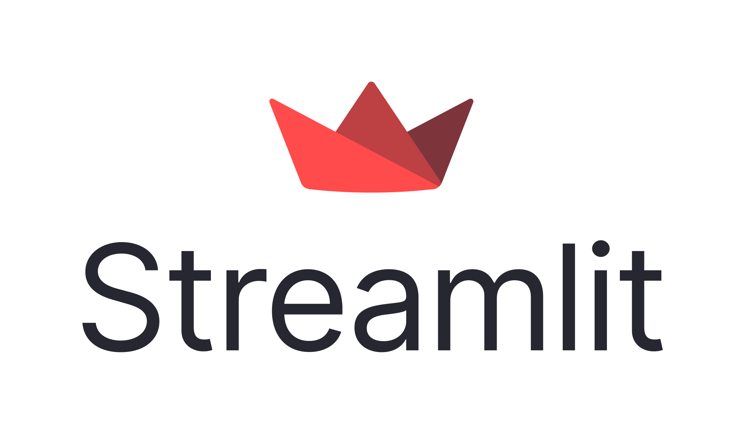
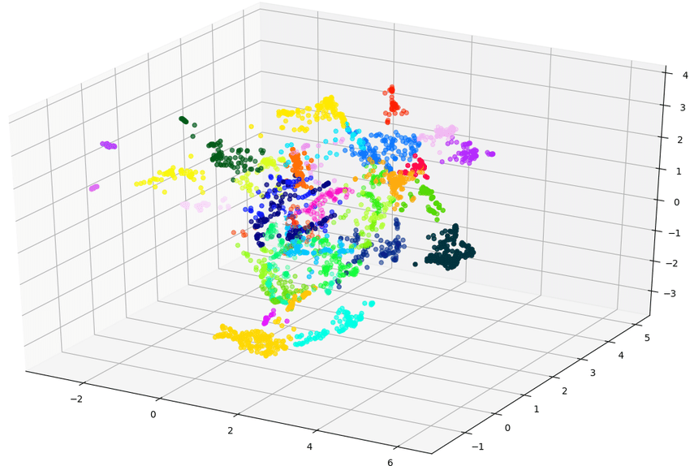


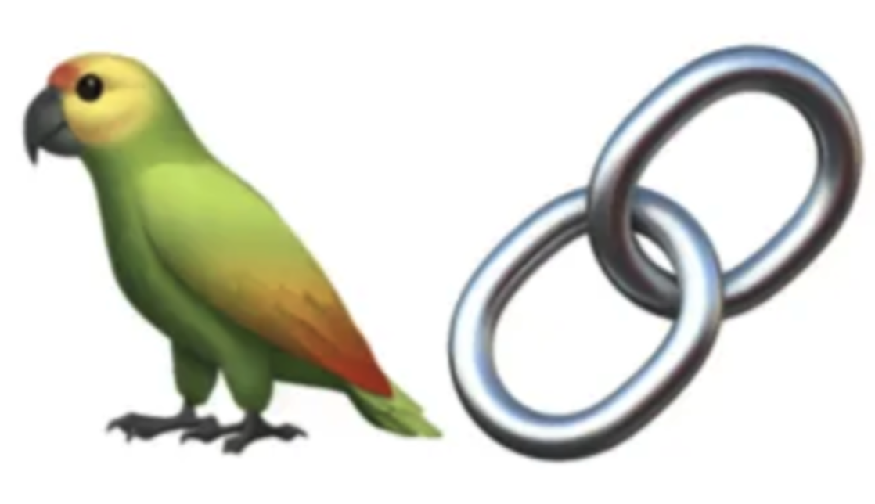
Chunking
index
1
code block
3
Azure AI Search
Web UI
Embedding
2
Azure Open AI
Embedding

Slide 9
Azure Open AI
GPT
5
prompt
6
4
Vector Search
Azure AI Search
1
Web UI
code block
2
3
Embedding
Azure Open AI
Embedding

Slide 10
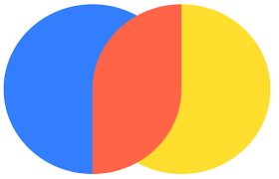
Chunking
index
1
code block
3
Vector Search by Chroma
Web UI
Embedding
2
Chroma
Embedding

Slide 11

Azure Open AI
GPT
Llama 2
4
prompt
5
3
Vector Search
Vector Search by Chroma
Web UI
code block
1
2
Embedding
Chroma
Embedding

